Slide 1
oops in java
Presented By : Pratiksha Sapkale

Slide 2
Introduction to OOPS
OOP’s stands for Object Oriented Programming.
It is a concept of using objects in programming to implement real-world entities.
OOP provides a clear syntax for our code making it easier to execute the code.

Slide 3
The key concepts in OOP include
Object & Class
Inheritance
Polymorphism
Abstraction
Encapsulation

Slide 4
OBJECT AND CLASs
An object can be any real-world entity such as a book, cupboard, pen, paper, fan, etc. While a class is a group of objects with similar properties.
An object is an instance of a class while a class is a blueprint from which we create objects.
Syntax to create object from class :
className objectName = new ClassName();

Slide 5
INHERITANCE
Inheritance is the mechanism by which one class acquires the properties and features of another class.
The class that inherits the properties is called as a sub-class (child class) while the class from which the property is inherited is called as the super-class (parent class).
A child class inherits properties of parent class with the help of extends keyword .
Syntax :
class childClass extends parentClass {
}

Slide 6
Inheritance can be further divided into the following types:
Single level
Multi-level
Hierarchical

Slide 7
single-level Inheritance :
When a single class inherits the attributes and methods of another class, it is known as single inheritance.
MULTI-LEVEL INHERITANCE:
When class 3 inherits from class 2, which itself is derived from a superclass, it is known as Multilevel Inheritance.
It forms a child-parent-grandparent (or a parent-child-grandchild) relationship. Meaning that child inherits from the parent while the parent inherits from the grandparent.

Slide 8
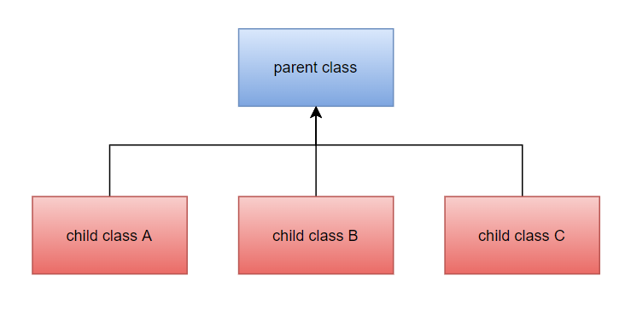
Hierarchical Inheritance :
Hierarchical inheritance is when two or more classes inherit from a single class. This can be easily visualized as a parent with more than one child. Here each child can inherit the properties of a parent.

Slide 9
Polymorphism
The word polymorphism is derived from the Greek words poly(means many), and morph(means form). Thus, polymorphism is the ability of an object to take more than one form.
Polymorphism is of two types :
Compile time polymorphism also known as static polymorphism, means that the method or function to call is determined at the time of compiling the code. This is usually achieved using method overloading .
Run time polymorphism Run-time polymorphism or dynamic method dispatch involves overriding a method at run-time instead of compile-time.

Slide 10
abstraction
Data abstraction refers to the process of hiding low level details and only displaying important information.
The abstract keyword is used to declare abstract classes. Abstract classes can have abstract and non-abstract methods.
Abstraction is achieved with the help of abstract classes and interfaces.

Slide 11
Encapsulation
Encapsulation in Java is a process of wrapping code and data together into a single unit.
For example, a capsule which is mixed of several medicines.
We use set method to set value of variable and get method to get the value of variable.
By providing only a setter or getter method, you can make the class read-only or write-only..

Slide 12
THANK YOU !

